Slide 1
Debt Buyer Collection Lawsuits or
“Do the Evidence Rules Really Matter?”
Philip D. Stern
Maplewood, NJ
January 15, 2013

Slide 2
ALLEGED CHAIN OF ASSIGNMENT
Chase Bank, N.A.
Sherman Originator III, LLC
Sherman Originator, LLC
LVNV Funding LLC
Sherman Acquisition LLC
New Century Financial Services, Inc.

Slide 3
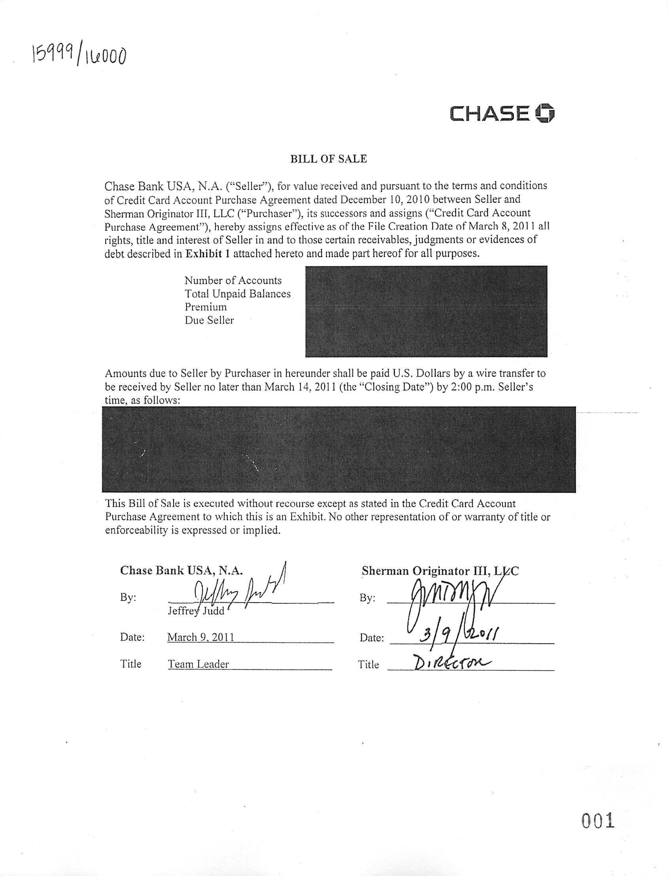

Slide 4
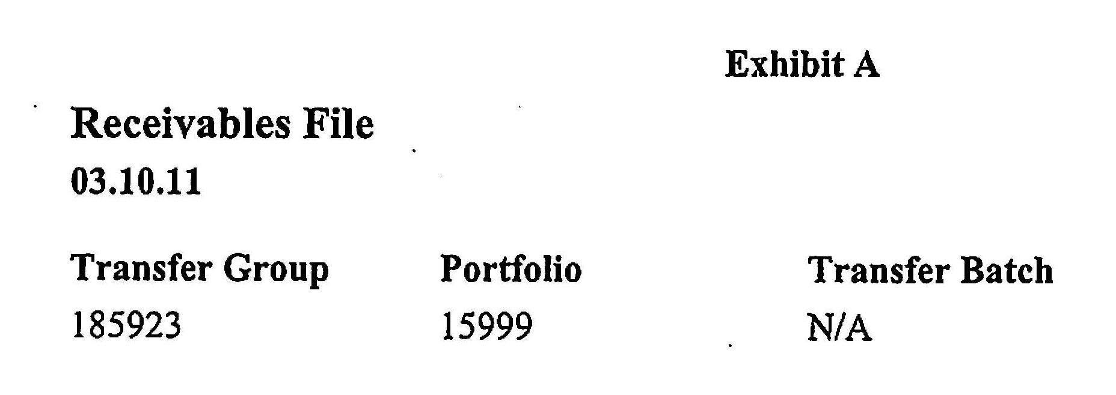
Where’s the Agreement?

Slide 5
Don’t come back
We don’t own
You can’t enforce it

Slide 6
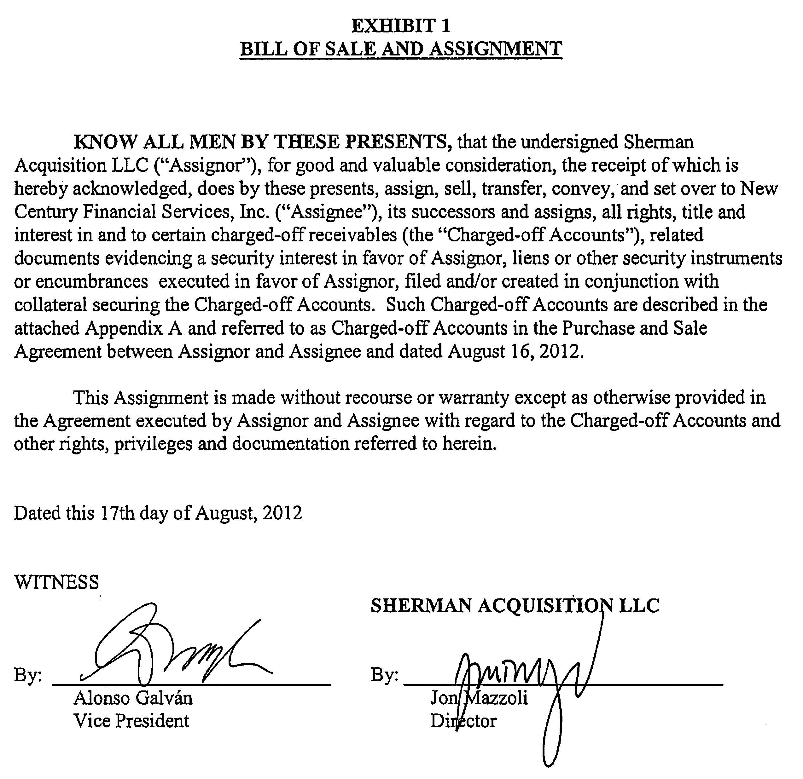

Slide 7
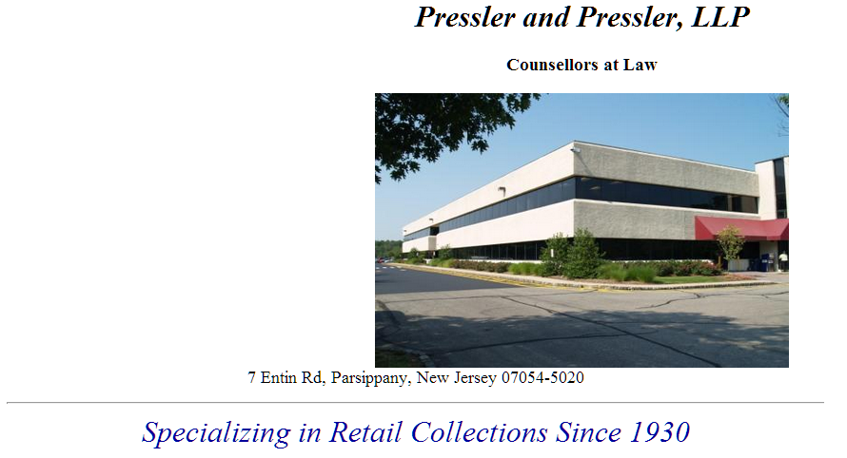

Home page at www.pressler-pressler.com
accessed January 15, 2013

Slide 8
1:21-5. Counsellors; Masters Abolished
The titles of Counsellor-at-law of this State, Master of the Superior Court, and Special Master, Commissioner or Examiner of the Superior Court are abolished.

Slide 9
RPC 7.4. Communication of Fields of Practice and Certification
(a) A lawyer may communicate the fact that the lawyer does or does not practice in particular fields of law. A lawyer may not, however, state or imply that the lawyer has been recognized or certified as a specialist in a particular field of law except as provided in paragraphs (b), (c), and (d) of this Rule.

Slide 10

Cross of MARKO GALIC, New Century witness – February 3, 2012
Q: P-8, pages 4 and 5 which is the LVNV to Sherman Acquisition transfer – where does it anywhere identify Ms. Jennings’ account?
A: It does not.

Slide 11

Cross of MARKO GALIC, New Century witness – February 3, 2012
A: This [the Bill of Sale] is a part of the Purchase and Sale Agreement.
Q: So the Purchase and Sale Agreement, which describes what you bought – the terms and conditions and the quality of what you bought – is described in another document you didn’t bring
A: Yes.

Slide 12
Cross of MARKO GALIC, New Century witness – February 3, 2012
Q: Do you have any personal knowledge as to how – the billing statements reflected in P-7 were created?
A: No.
Q: Do you have any personal knowledge as to any of the billing statements from Chase are created?
A: No.
Q: Do you know how Chase maintains its records?
A: I do not work for Chase, no.
Q: Do you have personal knowledge as to whether they were created in the ordinary course of business?
A: No.
Q: Do you have personal knowledge as to whether they were created at or about the time of the information reflected in those documents?
A: No.
Q: Do you have any personal knowledge as to whether the information contained in those came from someone who had personal knowledge as to the information in the documents?
A: No.

Slide 13
Cross of MARKO GALIC, New Century witness – February 3, 2012
Q: Your information about that account, at the time you purchased the account, was in this Excel spreadsheet, correct?
A: Correct.
Q: And we’ve already established that the Excel spreadsheet was something that was created after it was in default?
A: Yes.
Q: Do you know who actually created the Excel spreadsheet?
A: It was created by Sherman Financial.
Q: How do you know that?
A: Because they told us they created it and sold it to us.
Q: Did you get an affidavit from them saying, you know, “we certify that all this information is accurate and true?”
LANG: Your Honor, we stipulated that it was without recourse and without warranties except as provided in the Agreement.

Slide 14
Cross of MARKO GALIC, New Century witness – February 3, 2012
JUDGE: The question is whether they got an affidavit.
LANG: At this point I have to object. I fail to see where any of these questions remotely involve how much Ms. Meloskie* owes, if anything.
JUDGE: They do more than remotely relate to that because counsel is attacking the veracity of this chain of title and the creation of these records. The problem is –
LANG: I understand that.
JUDGE: These records – in other words, all you have are people at New Century pushing buttons on a computer and getting records without any personal knowledge of what’s going on?
LANG: That’s exactly correct, Your Honor.
JUDGE: And that’s the problem.
*Lang mistakenly refers to a defendant in another case.

Slide 15
Feel free to use what you want!
http://www.philipstern.com/Appeals.html
Briefs covering:
  Valid Assignment is a threshold standing issue.
  Assignment requires (1) identification of account, (2) unambiguous intent to assign, and (3) notice to the obligor.
  Elements to prove liability on a purchased debt.
  Evidentiary issues: primarily hearsay.

