Slide 1
Assignment Doc Excerpts

Slide 2
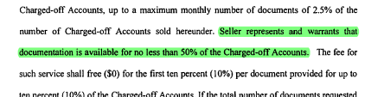
From Chase Forward Flow

Slide 3
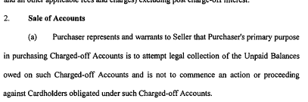
From Chase Forward Flow

Slide 4
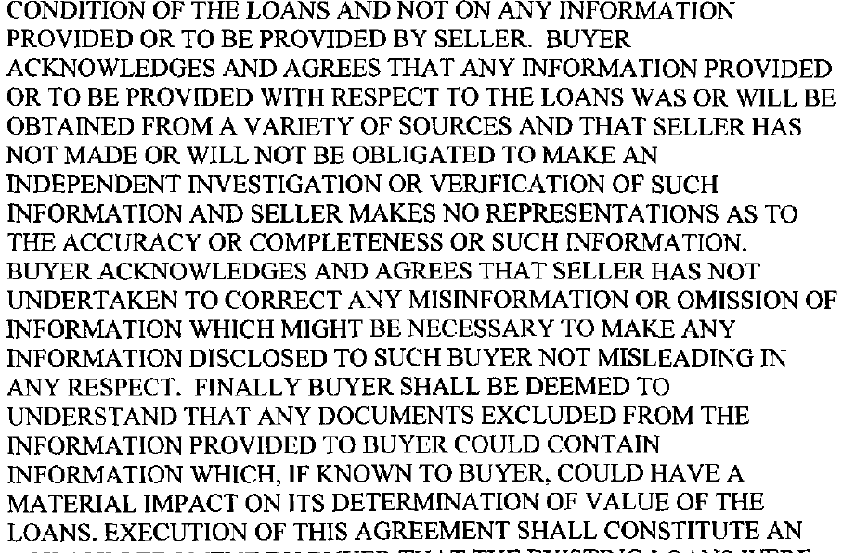
FIA Forward Flow

Slide 5
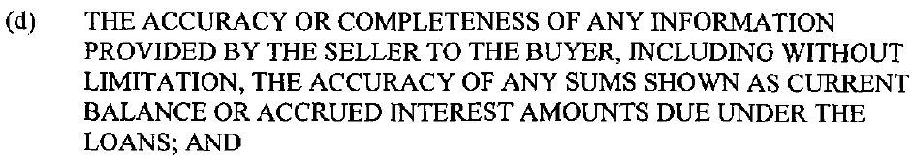
FIA Forward Flow

Slide 6
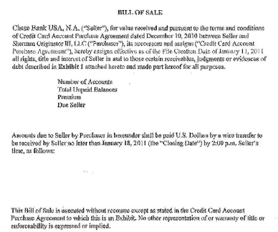
Chase Bill of Sale - excerpt

Slide 7
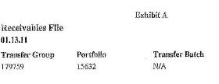
Chase Bill of Sale - Exhibit

Slide 8
Chase Bill of Sale - excerpt

